Slide 1


Mastering Order Types
The essential tools you need to buy and sell like a pro.

Slide 2


The Need for Speed: Market Order
A Market Order is an instruction to buy or sell a stock immediately at the current best available price.
Guaranteed Execution: Your order will almost certainly go through instantly.
No Price Guarantee: You take whatever price the market offers at that exact second.
Beware of Slippage: In fast-moving or low-volume markets, the final price might be slightly worse than what you saw on the screen.

Slide 3
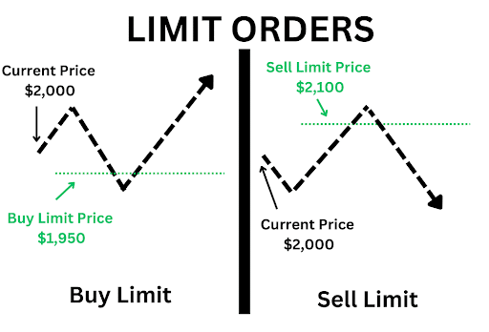
The Bargain Hunter: Limit Order
A Limit Order allows you to set the exact maximum price you are willing to pay, or the minimum you are willing to accept.
Price Control: You dictate the terms. If the stock trades at ₹105, you can place a limit order to buy only if it drops to ₹100.
No Execution Guarantee: If the stock never reaches your specified limit price, your order will remain unfilled and eventually expire.
Best for Patience: Ideal for investors who want a specific entry point and refuse to overpay.

Slide 4

Your Safety Net:
Stop Loss (SL)
A Stop Loss order is an automatic trigger designed to limit your potential losses on a trade.
How it works: If you buy a stock at ₹100, you can place a Stop Loss at ₹95. If the price falls to ₹95, your order automatically converts into a Market Order to sell.
Why it's crucial: It takes the emotion out of trading. It acts as an insurance policy, ensuring a small loss never turns into a catastrophic one.

Slide 5


Precision Protection: Stop Limit Order
1. The Trigger (Stop Price)
2. The Execution (Limit Price)
This is the activation point. When the stock reaches this specific price, your order wakes up and becomes active.
Once triggered, your order is placed on the exchange as a strict Limit Order. It will only execute at this exact price or better.
Unlike a regular Stop Loss, it does not immediately sell at the market price. Instead, it triggers the next step.
Use Case: Prevents your stop loss from triggering a massive slippage sell-off during a sudden flash crash.

Slide 6
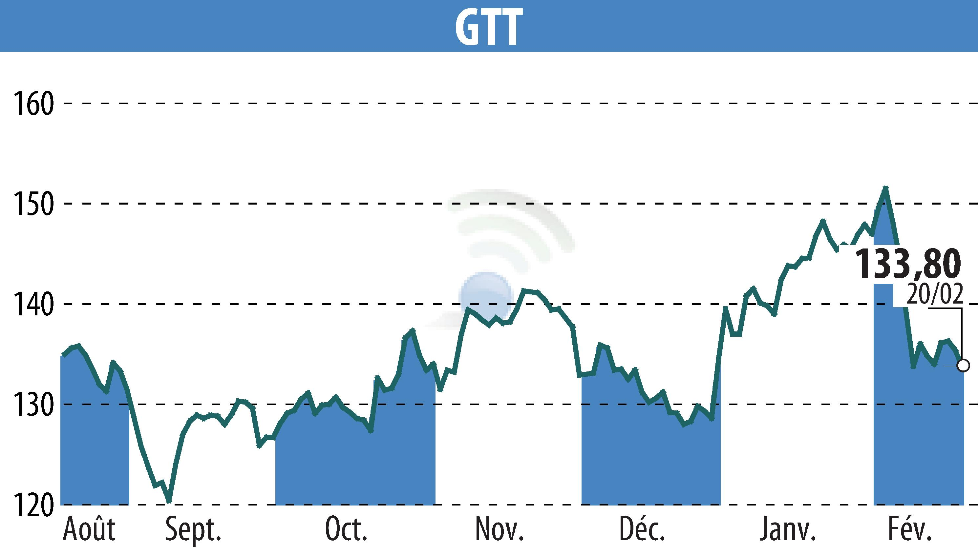
Set It & Forget It: GTT Orders
Good Till Triggered
Most standard orders expire at the end of the trading day. If they aren't filled by 3:30 PM, they are canceled.
The Solution: GTT orders remain active in the system for up to 1 entire year (or until triggered).
Perfect for: Busy students and part-time investors who can't watch the screen all day but want to buy a stock if it ever crashes 20% in the future.

Slide 7

Now or Never: IOC
Zero Patience Order
An IOC order dictates that the trade must be executed the very millisecond it reaches the exchange.
IOC
Partial Fills Allowed: If you want to buy 1,000 shares but only 400 are available instantly, the system will buy the 400 and immediately cancel the remaining 600.
IMMEDIATE OR CANCEL
It never sits in the order book waiting. It's either filled right now, or thrown away.

Slide 8









The Default Standard: Day Order
Activation
Cancellation
Duration
A Day Order becomes active the moment it is placed during regular market hours, aiming for your limit or market target.
If the order is not filled by the closing bell, the system automatically deletes it. You must place a new order tomorrow.
It remains patiently in the exchange's order book for the entirety of the trading session (until 3:30 PM IST).

Slide 9
Great Job on Day 8!
Tomorrow: Trading Sessions.
Don't forget to Like, Share, and Subscribe!
/ @EarnJoyOfficial

